Slide 1
讲义1：宏观经济学介绍和概念
陈玉宇
2016

Slide 2
学习目标
1 什么是宏观经济学？与微观经济学的区别
2 宏观经济学关心的三个主题：增长、失业和通胀
3 初步了解GDP的概念
4 GDP的构成
5 真实GDP和名义GDP

Slide 3
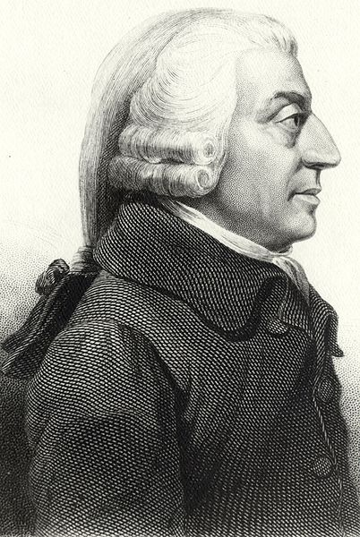
经济学之父亚当斯密论市场经济
Every individual endeavors to employ his capital so that its produce may be of greatest value. He generally neither intends to promote the public interest, nor knows how much he is promoting it. He intends only his own security, only his own gain. And he is in this led by an invisible hand to promote an end which of no part of his intention. By pursuing his own interest he frequently promotes that of society more effectively than when he really intends to promote it.
每个人都努力地利用自己的资本，最大化自己的产出。他这样做，既不是为了公共利益，他也不知道自己创造了多少公共利益。他只追求自己的安定，追求自己的私利。他就像被一只看不见的手引导着，无意之中促进了公共利益。在追求自己的私利过程中，他无意中造成的公共利益的增加，要远远大于当他有意去促进公共利益时候所造成的增加。

Slide 4
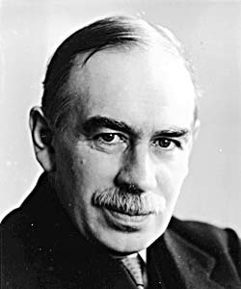
宏观经济学之父凯恩斯论思想
经济学家和政治学家的思想，无论他们对还是错，都比常人理解的要有力量。的确，统治世界就是这些思想。实干家，自以为不受这些理论的束缚，可他们常常是某个死去的经济学家的思想的奴隶。目空一切的权力者，所持有狂妄荒诞的念头，也往往是从多年前学术界的某个蹩脚经济学家那偷来的。
我确信，跟思想的侵蚀能力相比，既得利益集团的力量被高估了。诚然，这不是就思想立即产生的影响而言，而是指过一段时间。因为在经济学和政治学领域，25或30岁以后还受新思想影响的人是不多的，因此，公务员，政客甚至煽动者，所应用的思想不大可能是最新的。但是，不论早晚，不论好坏，危险的东西不是既得利益，而是思想。

Slide 5
1 What is Macroeconomics?
Macroeconomics is the study of the behaviour of the economy as a whole.
Two central themes
  Short term fluctuations in output, employment, financial conditions and prices that we call the business cycle.
  The long term trends in output and living standards known as economic growth.

Slide 6
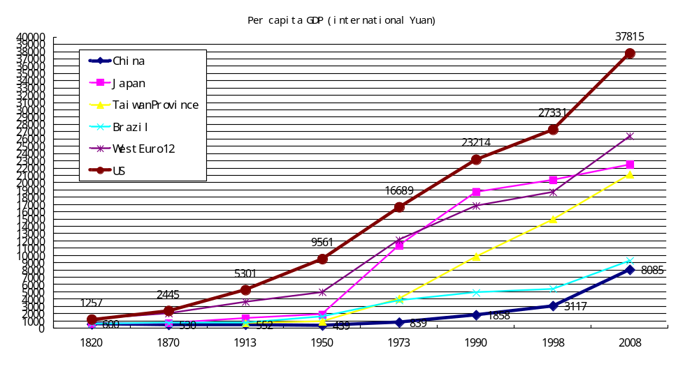

Slide 7
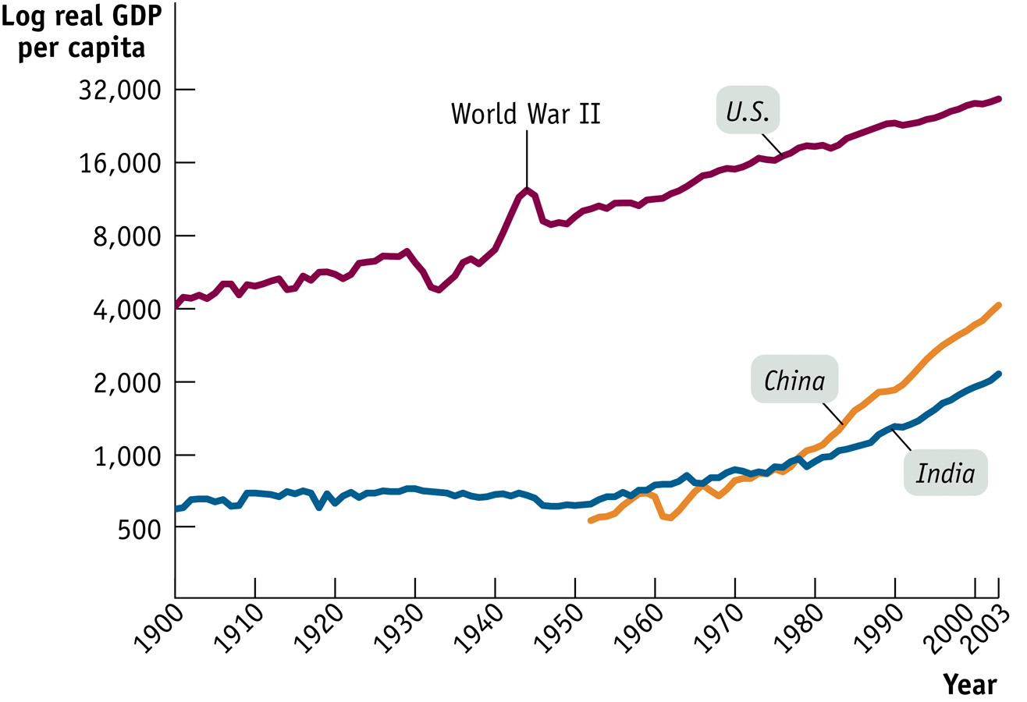

Slide 8
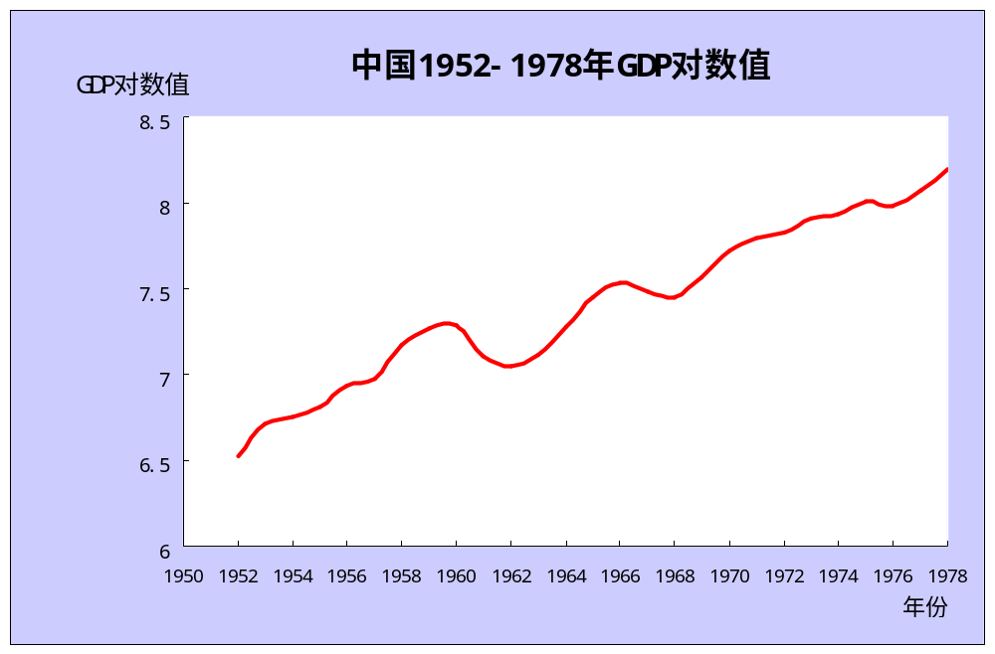

Slide 9
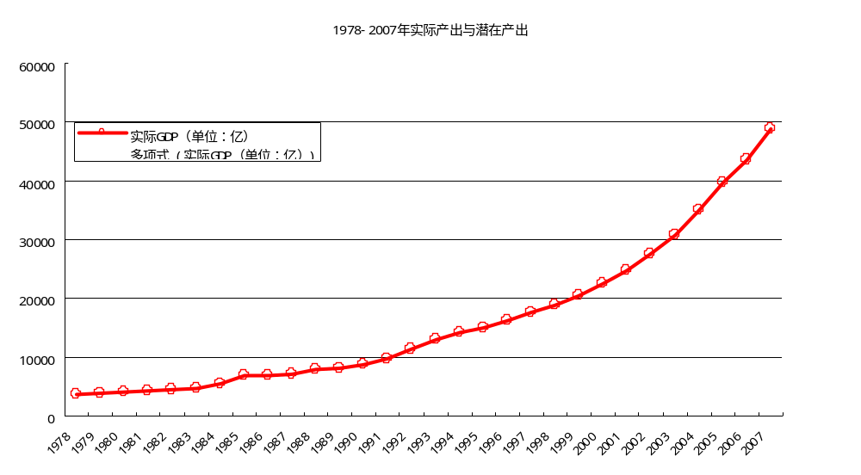
增长和波动

Slide 10
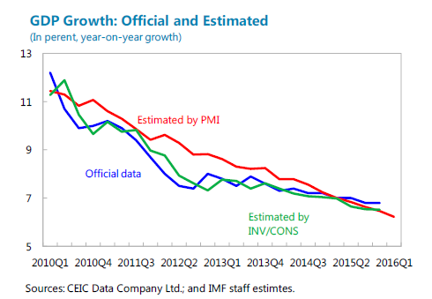

Slide 11
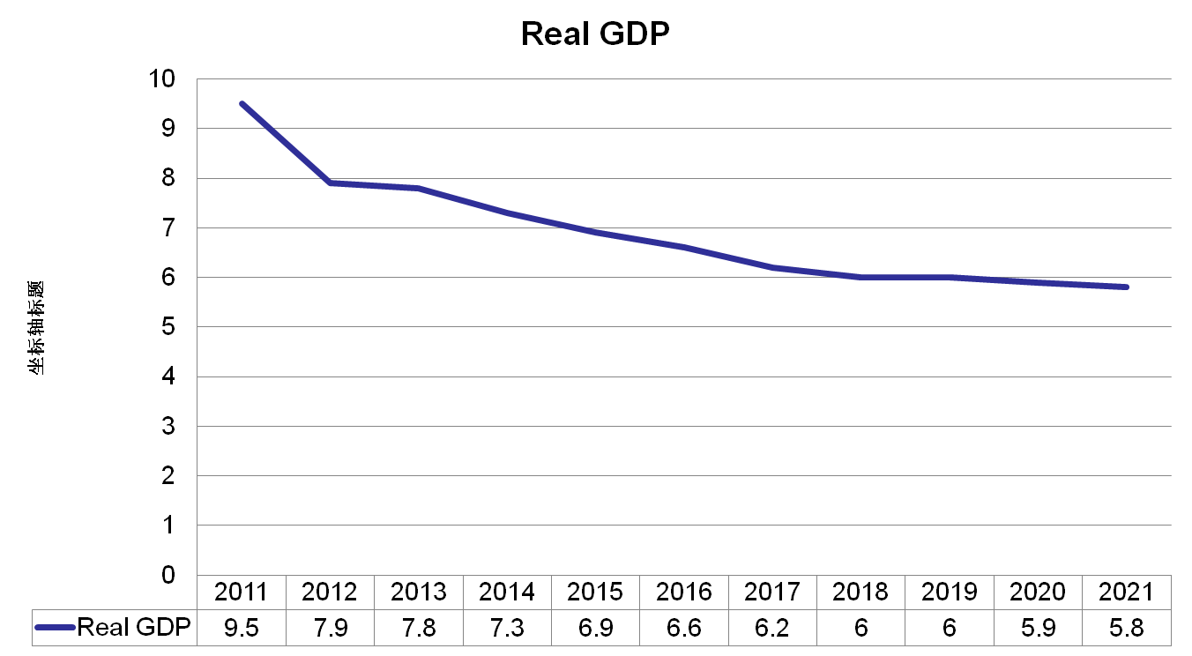

Slide 12
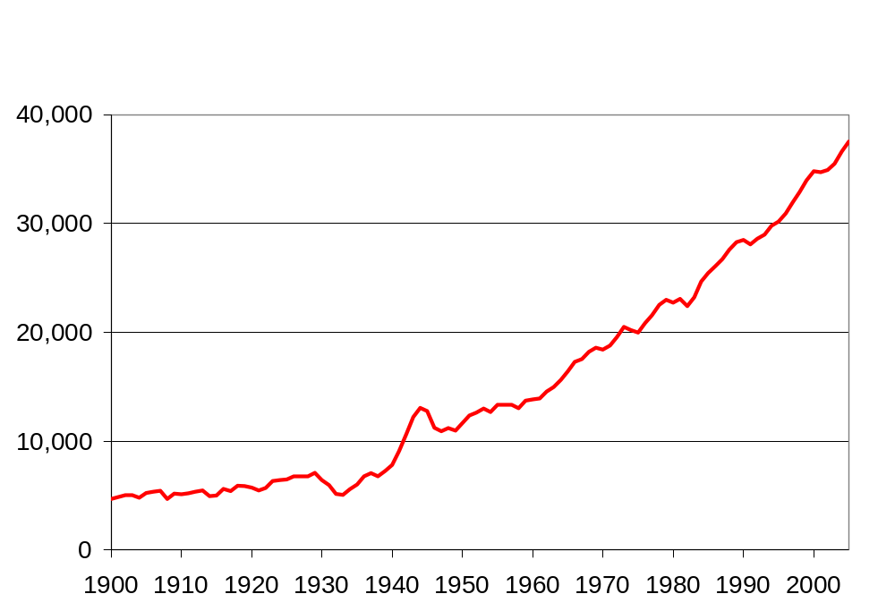
U.S. Real GDP per capita
(2000 dollars)
911
第一次石油危机
长期趋势…
大危机
第二次石油危机
二战

Slide 13
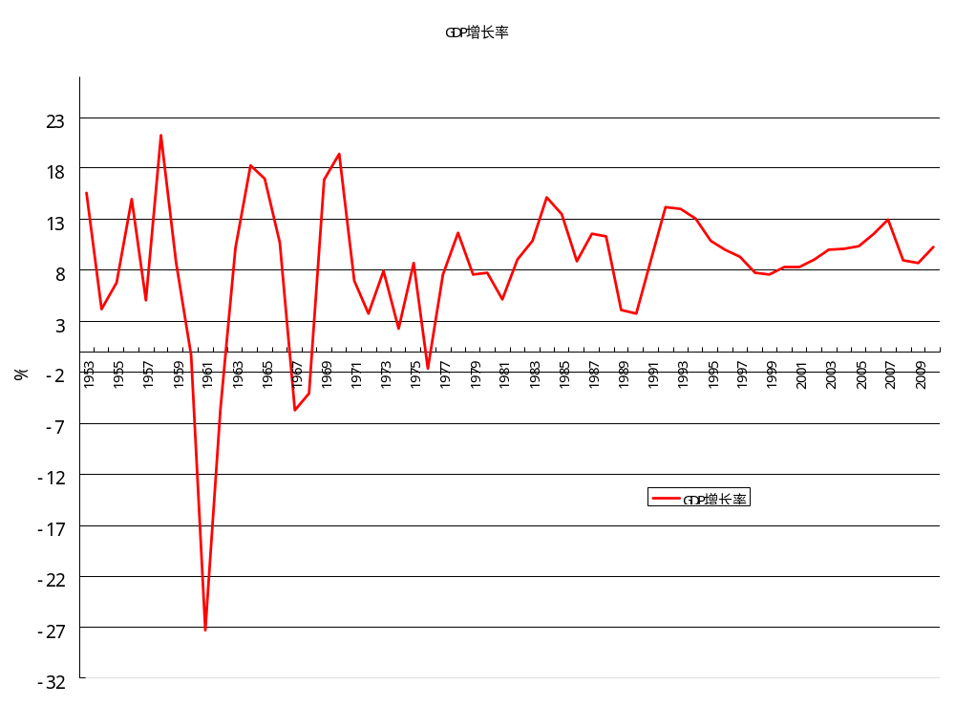

Slide 14
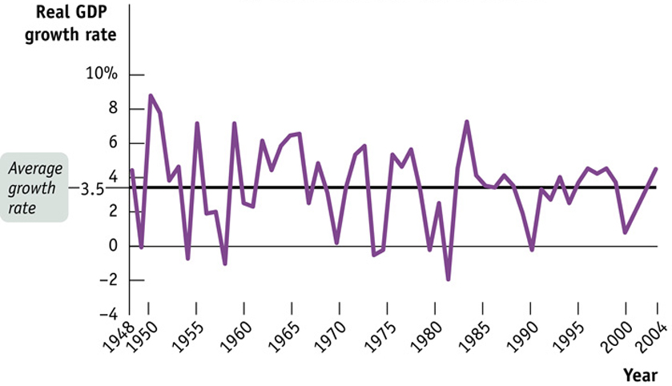
美国

Slide 15
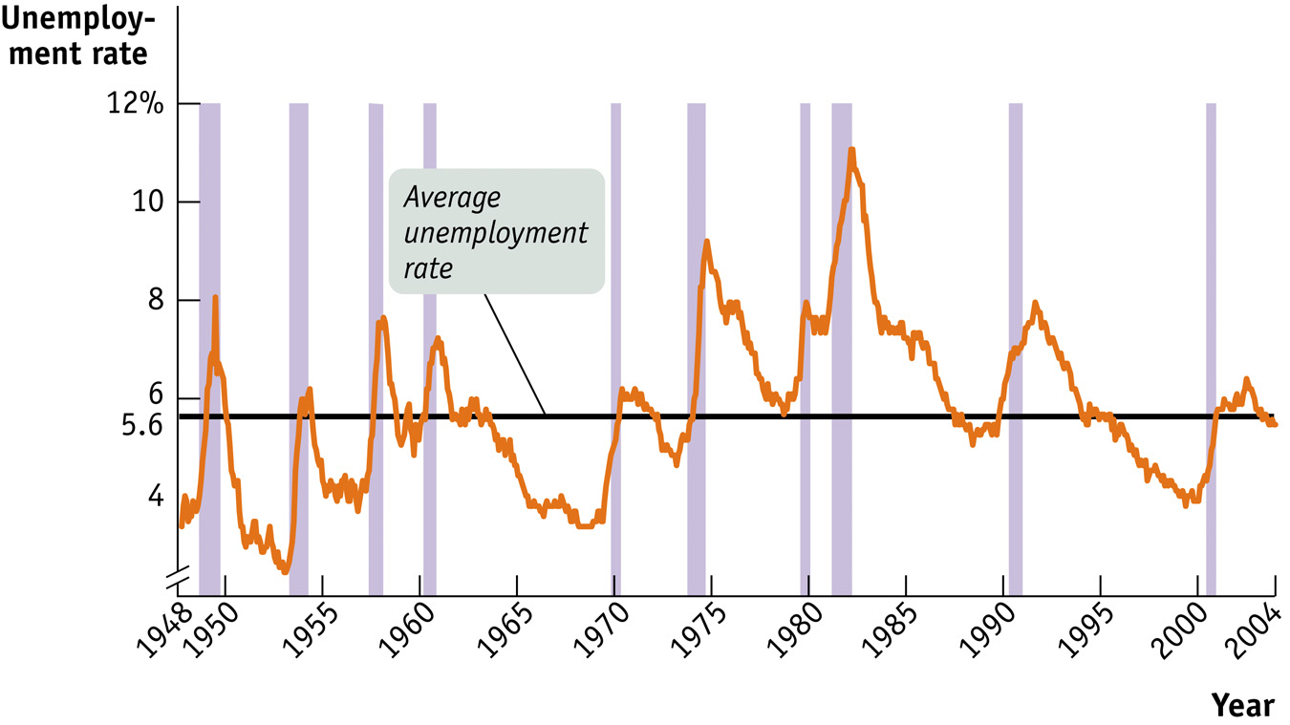
美国：失业角度看

Slide 17
2 Key Concepts
The birth of macroeconomics
1946 Employment Act
  The federal government’s responsibility
  Promoting output growth
  Fostering employment
  Maintaining price stability

Slide 18
Three central questions of macroeconomics
Why do output and employment sometimes fall, and how can unemployment be reduced?
What are sources of price inflation, and how can it be kept under control?
How can a nation increase its rate of economic growth?

Slide 19

Objectives and Instruments

Slide 20
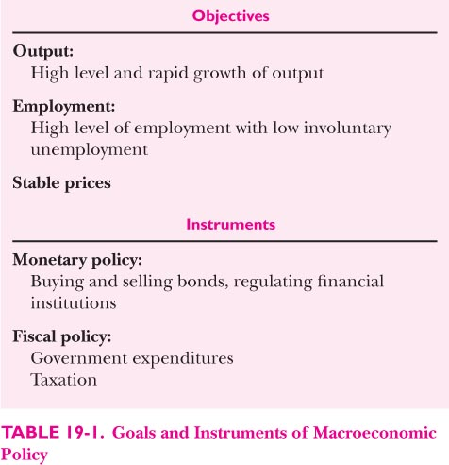

Slide 21
Measuring economic sucess
Output
  GDP is the measure of th emarket value of all final goods and services
  Nominal or real GDP
  Growth rate (ln, exp)

Slide 22
Measuring Economic success
  Output
  GDP defination
  Growth rate

Slide 23
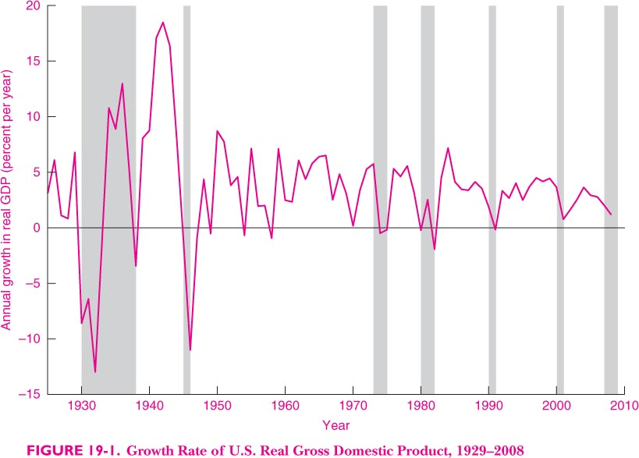

Slide 24
  Potential GDP
  Represents the maximum sustainable level of output that economy can produce
  Recession and depression

Slide 25
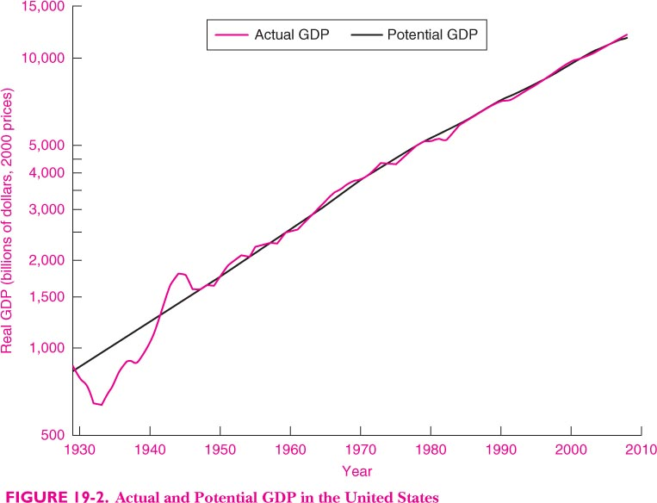

Slide 26
  High employment, low employment
  Labor force
  Unemployment
  Employment
  Participation

Slide 27
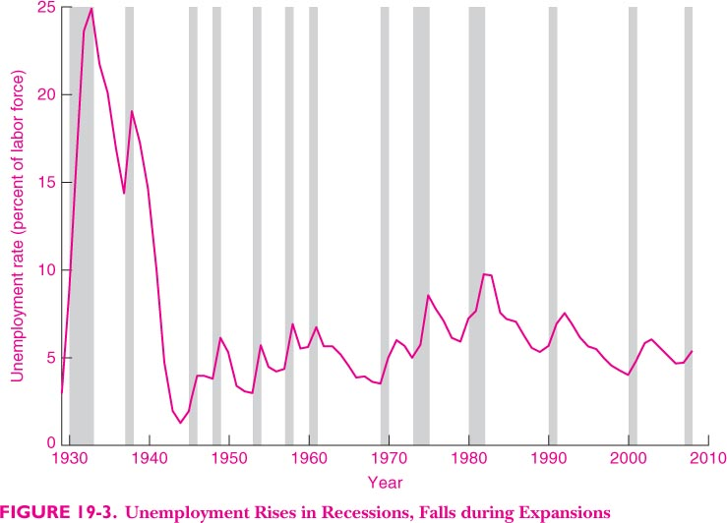

Slide 28
  Price stability
  CPI
  Inflation
  Rate of inflation
  Deflation
  Hyperinflation

Slide 29
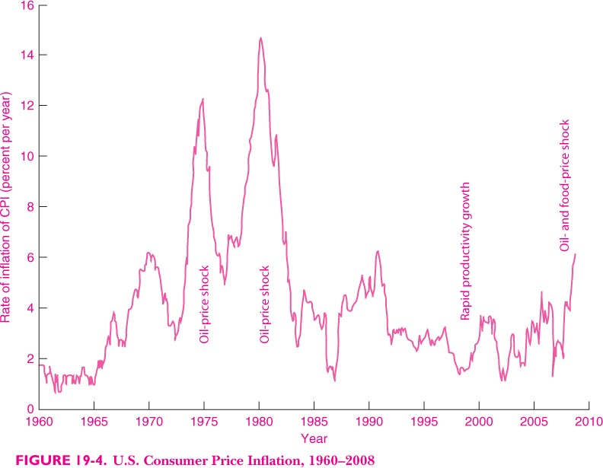

Slide 30
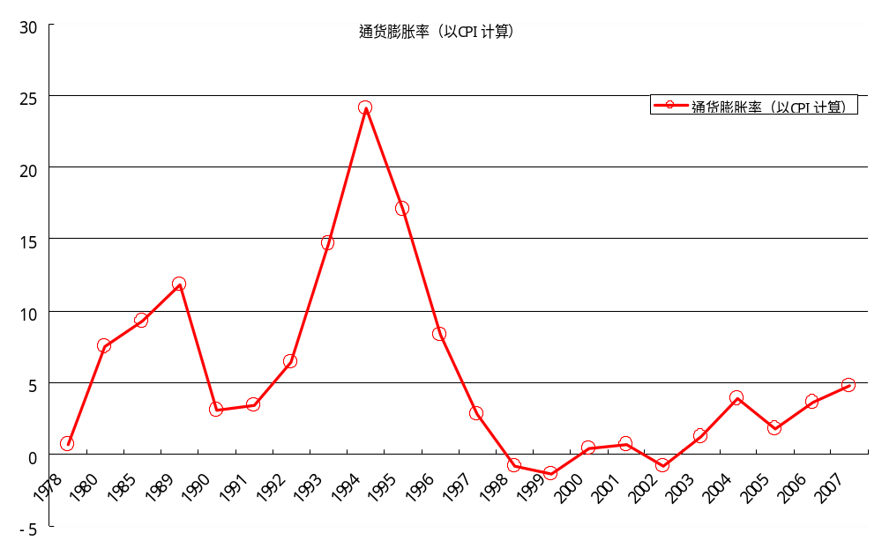

Slide 31
The tools of macroeconomics
Fiscal policy
  Government expending
  Taxation
Monetary policy
  Interest rate
  Required reserve ratio
  Money supply

Slide 32
International linkages
Globalization
Trade linkage: export and import
Current account
Trade policies
International financial management
Exchange rate

Slide 33
3. Aggregate supply and demand
Inside the macroeconomy: Aggregate supply and demand
  Definition of aggregate supply and demand
  Aggregate supply
  Aggregate demand: components
    Consumption
    Investment
    Government purchases
    Net export
  Macroeconomic equilibrium

Slide 34
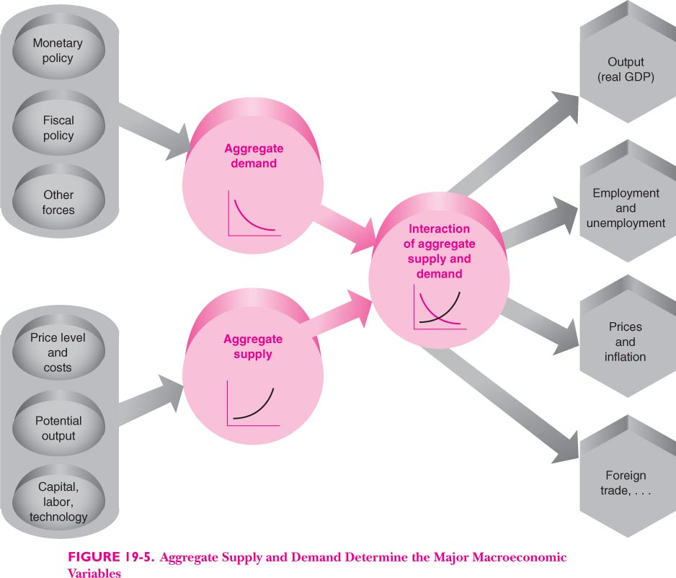

Slide 35
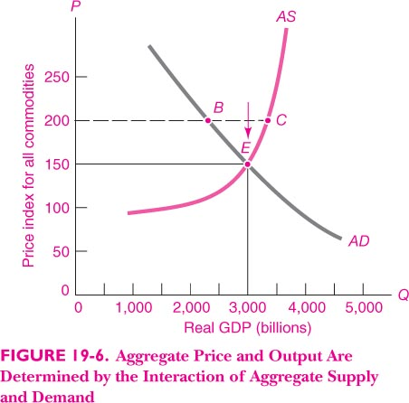

Slide 36
Macroeconomic history: 1900-2008
  Wartime Boom
  Tight Money, 1979-1982
  The Growth Century
The Role of Macroeconomic Policy

Slide 37
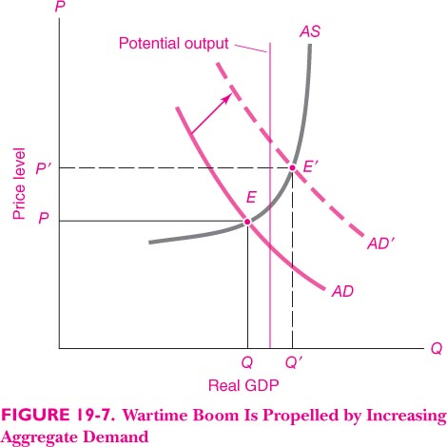

Slide 38
The macroeconomic history (U.S.)
War time boom
Tight money 1979-1982
The growth centrary

Slide 39
Macroeconomic history of China
Before 1949
Before 1979
1979-1993
1993-2008
2009-

Slide 40
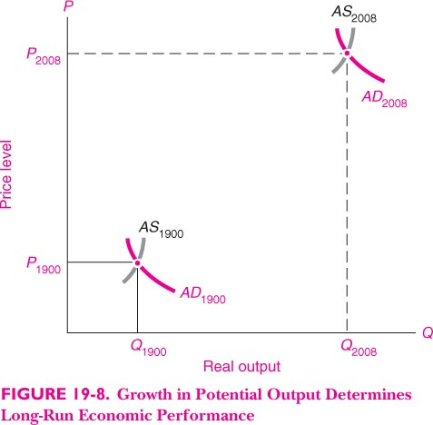

Slide 41
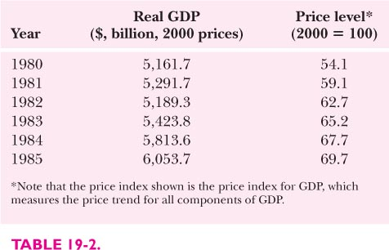
Macroeconomic data for the US

Slide 42
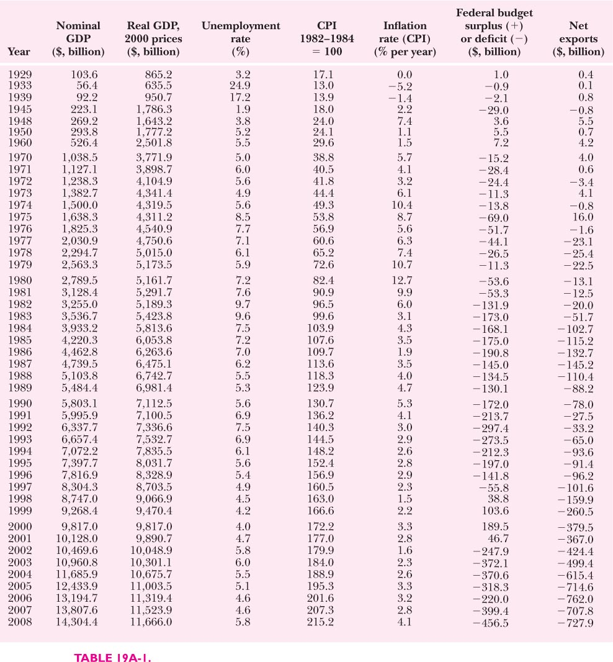

Slide 43
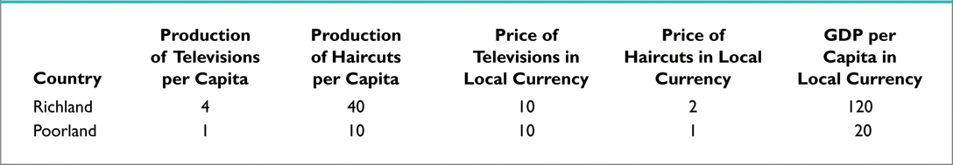
例子：穷国和富国的生产与价格

Slide 44
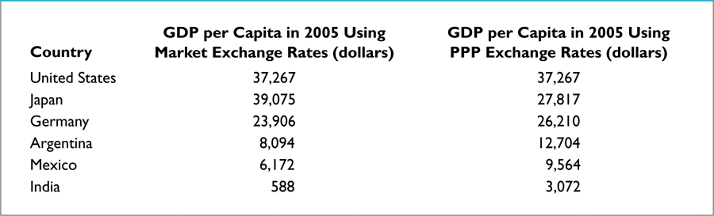
用PPP和不用PPP的差异

Slide 45
持续的人均收入或产出的增长
长期经济增长很重要
是近代以来的事情
一个国家2%，200年，多少倍
1%呢

Slide 46
中国1800-1950，年均增长率-0.2%，天那
我们在经济增长的部分，将详细探究经济增长的事实、规律和原因

Slide 47
Economy’s Income & Expenditure
Gross Domestic Product (GDP)
  Measures the total income of everyone in the economy
  Measures the total expenditure on the economy’s output of goods and services
For an economy as a whole
  Income must equal expenditure
© 2015 Cengage Learning. All Rights Reserved. May not be copied, scanned, or duplicated, in whole or in part, except for use as permitted in a license distributed with a certain product or service or otherwise on a password-protected website for classroom use.

Slide 48
Economy’s Income & Expenditure
Circular-flow diagram – assumptions:
  Markets
    Goods and services
    Factors of production
  Households
    Spend all of their income
    Buy all goods and services
  Firms
    Pay wages, rent, profit to resource owners
© 2015 Cengage Learning. All Rights Reserved. May not be copied, scanned, or duplicated, in whole or in part, except for use as permitted in a license distributed with a certain product or service or otherwise on a password-protected website for classroom use.

Slide 49
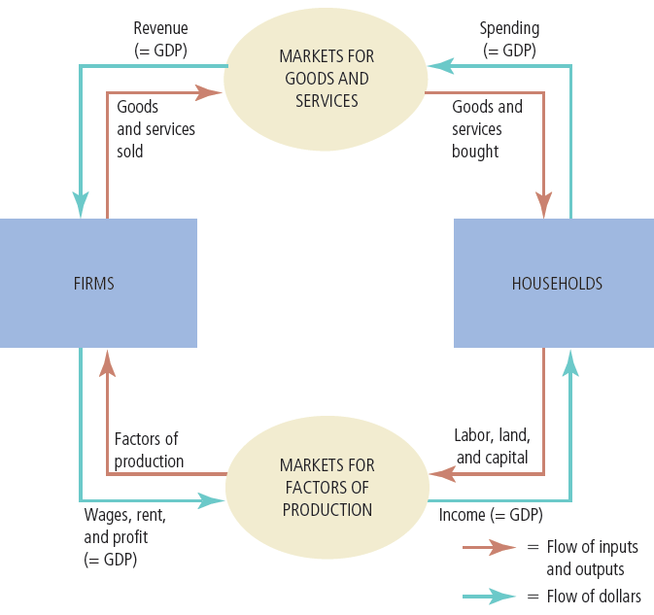
The Circular-Flow Diagram
Households buy goods and services from firms, and firms use their revenue from sales to pay wages to workers, rent to landowners, and profit to firm owners. GDP equals the total amount spent by households in the market for goods and services. It also equals the total wages, rent, and profit paid by firms in the markets for the factors of production.
© 2015 Cengage Learning. All Rights Reserved. May not be copied, scanned, or duplicated, in whole or in part, except for use as permitted in a license distributed with a certain product or service or otherwise on a password-protected website for classroom use.

Slide 50
The Measurement of GDP
Gross domestic product (GDP)
  Market value of all final goods and services
  Produced within a country
  In a given period of time
“GDP is the market value…”
  Market prices - reflect the value of the goods
© 2015 Cengage Learning. All Rights Reserved. May not be copied, scanned, or duplicated, in whole or in part, except for use as permitted in a license distributed with a certain product or service or otherwise on a password-protected website for classroom use.

Slide 51
The Measurement of GDP
“… of all…”
  All items produced in the economy
    And sold legally in markets
  Excludes most items
    Produced and sold illicitly
    Produced and consumed at home
© 2015 Cengage Learning. All Rights Reserved. May not be copied, scanned, or duplicated, in whole or in part, except for use as permitted in a license distributed with a certain product or service or otherwise on a password-protected website for classroom use.

Slide 52
The Measurement of GDP
“… final…”
  Value of intermediate goods is already included in the prices of the final goods
“… goods and services…”
  Tangible goods & intangible services
“… produced…”
  Goods and services currently produced
© 2015 Cengage Learning. All Rights Reserved. May not be copied, scanned, or duplicated, in whole or in part, except for use as permitted in a license distributed with a certain product or service or otherwise on a password-protected website for classroom use.

Slide 53
The Measurement of GDP
“… within a country…”
  Goods and services produced domestically
    Regardless of the nationality of the producer
“… in a given period of time”
  A year or a quarter
© 2015 Cengage Learning. All Rights Reserved. May not be copied, scanned, or duplicated, in whole or in part, except for use as permitted in a license distributed with a certain product or service or otherwise on a password-protected website for classroom use.

Slide 54
The Components of GDP
Y = C + I + G + NX
  Identity
  Y = GDP
  C = consumption
  I = investment
  G = government purchases
  NX = net exports
© 2015 Cengage Learning. All Rights Reserved. May not be copied, scanned, or duplicated, in whole or in part, except for use as permitted in a license distributed with a certain product or service or otherwise on a password-protected website for classroom use.

Slide 55
The Components of GDP
Consumption, C
  Spending by households on goods and services
  Exception: purchases of new housing
Investment, I
  Spending on capital equipment, inventories, and structures
  Household purchases of new housing
  Inventory accumulation
© 2015 Cengage Learning. All Rights Reserved. May not be copied, scanned, or duplicated, in whole or in part, except for use as permitted in a license distributed with a certain product or service or otherwise on a password-protected website for classroom use.

Slide 56
The Components of GDP
Government purchases, G
  Government consumption expenditure and gross investment
  Spending on goods and services
  By local, state, and federal governments
  Does not include transfer payments
© 2015 Cengage Learning. All Rights Reserved. May not be copied, scanned, or duplicated, in whole or in part, except for use as permitted in a license distributed with a certain product or service or otherwise on a password-protected website for classroom use.

Slide 57
The Components of GDP
Net exports, NX = Exports - Imports
  Exports
    Spending on domestically produced goods by foreigners
  Imports
    Spending on foreign goods by domestic residents
© 2015 Cengage Learning. All Rights Reserved. May not be copied, scanned, or duplicated, in whole or in part, except for use as permitted in a license distributed with a certain product or service or otherwise on a password-protected website for classroom use.

Slide 58
The components of U.S. GDP
2012, GDP of the U.S.: over $15 trillion
GDP per person = $49,923
  Consumption = $35,411 per person
  Investment = $6,557 per person
  Government purchases = $9,758 per person
  Net exports = –$1,806 per person
© 2015 Cengage Learning. All Rights Reserved. May not be copied, scanned, or duplicated, in whole or in part, except for use as permitted in a license distributed with a certain product or service or otherwise on a password-protected website for classroom use.

Slide 59
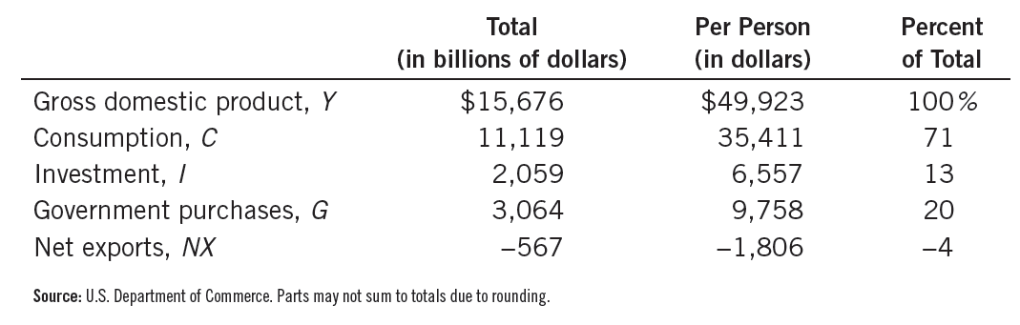
GDP and Its Components
This table shows total GDP for the U.S. economy in 2012 and the breakdown of GDP among its four components. When reading this table, recall the identity
Y = C + I + G + NX.
© 2015 Cengage Learning. All Rights Reserved. May not be copied, scanned, or duplicated, in whole or in part, except for use as permitted in a license distributed with a certain product or service or otherwise on a password-protected website for classroom use.

Slide 60
Real versus Nominal GDP
Total spending rises from one year to the next
  Economy - producing a larger output of goods and services
  And/or goods and services are being sold at higher prices
Nominal GDP
  Production of goods and services
  Valued at current prices
© 2015 Cengage Learning. All Rights Reserved. May not be copied, scanned, or duplicated, in whole or in part, except for use as permitted in a license distributed with a certain product or service or otherwise on a password-protected website for classroom use.

Slide 61
Real versus Nominal GDP
Real GDP
  Production of goods and services
  Valued at constant prices
  Designate one year as base year
  Not affected by changes in prices
For the base year
  Nominal GDP = Real GDP
© 2015 Cengage Learning. All Rights Reserved. May not be copied, scanned, or duplicated, in whole or in part, except for use as permitted in a license distributed with a certain product or service or otherwise on a password-protected website for classroom use.

Slide 62
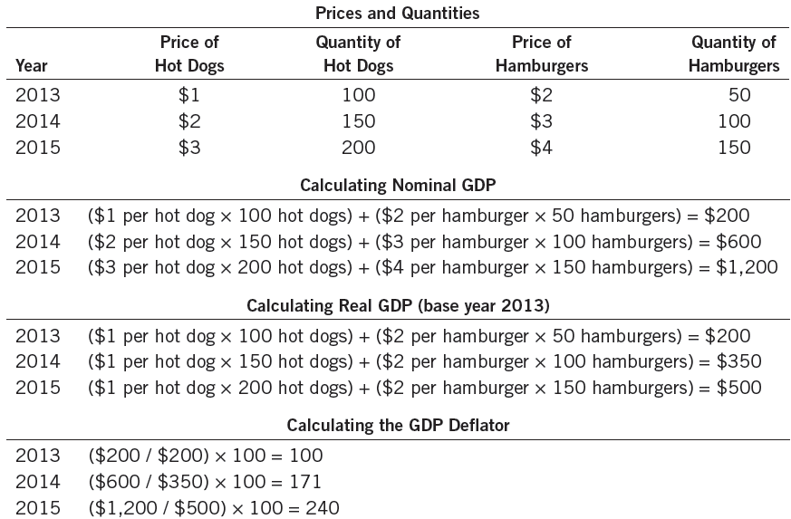
Real and Nominal GDP
This table shows how to calculate real GDP, nominal GDP, and the GDP deflator for a hypothetical economy that produces only hot dogs and hamburgers.
© 2015 Cengage Learning. All Rights Reserved. May not be copied, scanned, or duplicated, in whole or in part, except for use as permitted in a license distributed with a certain product or service or otherwise on a password-protected website for classroom use.

Slide 63
Real versus Nominal GDP
The GDP deflator
  Ratio of nominal GDP to real GDP times 100
  Is 100 for the base year
  Measures the current level of prices relative to the level of prices in the base year
  Can be used to take inflation out of nominal GDP (“deflate” nominal GDP)
© 2015 Cengage Learning. All Rights Reserved. May not be copied, scanned, or duplicated, in whole or in part, except for use as permitted in a license distributed with a certain product or service or otherwise on a password-protected website for classroom use.

Slide 64
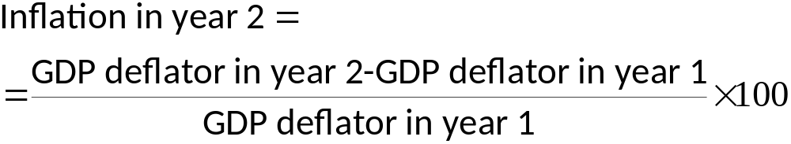
Real versus Nominal GDP
Inflation
  Economy’s overall price level is rising
Inflation rate
  Percentage change in some measure of the price level from one period to the next
© 2015 Cengage Learning. All Rights Reserved. May not be copied, scanned, or duplicated, in whole or in part, except for use as permitted in a license distributed with a certain product or service or otherwise on a password-protected website for classroom use.

Slide 65
Real GDP over recent history
The GDP data
  Real GDP grows over time
  Growth – average 3% per year since 1965
  Growth is not steady
    GDP growth interrupted by recessions
© 2015 Cengage Learning. All Rights Reserved. May not be copied, scanned, or duplicated, in whole or in part, except for use as permitted in a license distributed with a certain product or service or otherwise on a password-protected website for classroom use.

Slide 66
Real GDP over recent history
Recession
  Two consecutive quarters of falling GDP
  Real GDP declines
  Lower income
  Rising unemployment
  Falling profits
  Increased bankruptcies
© 2015 Cengage Learning. All Rights Reserved. May not be copied, scanned, or duplicated, in whole or in part, except for use as permitted in a license distributed with a certain product or service or otherwise on a password-protected website for classroom use.

Slide 67
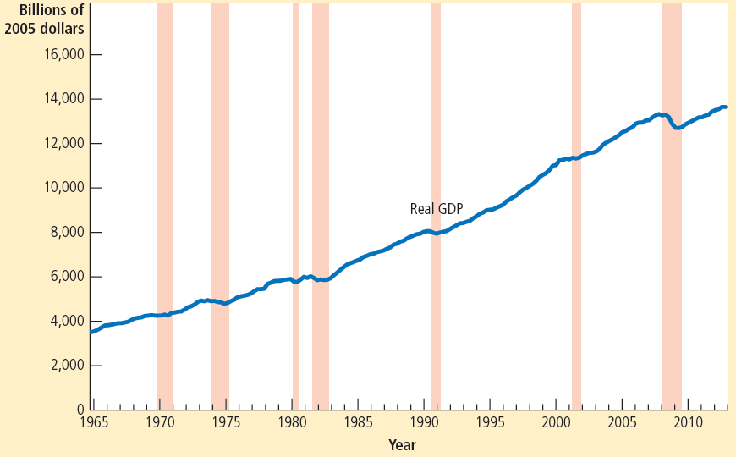
Real GDP in the United States
This figure shows quarterly data on real GDP for the U.S. economy since 1965. Recessions— periods of falling real GDP—are marked with the shaded vertical bars.
© 2015 Cengage Learning. All Rights Reserved. May not be copied, scanned, or duplicated, in whole or in part, except for use as permitted in a license distributed with a certain product or service or otherwise on a password-protected website for classroom use.

Slide 68
GDP
GDP – “the best single measure of the economic well-being of a society”
  Economy’s total income
  Economy’s total expenditure
  Larger GDP
    Good life, better healthcare
    Better educational systems
  Measure our ability to obtain many of the inputs into a worthwhile life
© 2015 Cengage Learning. All Rights Reserved. May not be copied, scanned, or duplicated, in whole or in part, except for use as permitted in a license distributed with a certain product or service or otherwise on a password-protected website for classroom use.

Slide 69
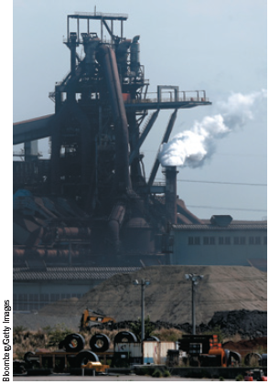
GDP
GDP – not a perfect measure of well-being
  Doesn’t include
    Leisure
    Value of almost all activity that takes place outside markets
    Quality of the environment
  Nothing about distribution of income
GDP reflects the factory’s
production, but not the harm it inflicts on the environment.
© 2015 Cengage Learning. All Rights Reserved. May not be copied, scanned, or duplicated, in whole or in part, except for use as permitted in a license distributed with a certain product or service or otherwise on a password-protected website for classroom use.

Slide 70
International differences: GDP & quality of life
Rich countries - higher GDP per person
  Better
    Life expectancy
    Literacy
    Internet usage
Poor countries - lower GDP per person
  Worse
    Life expectancy
    Literacy
    Internet usage
© 2015 Cengage Learning. All Rights Reserved. May not be copied, scanned, or duplicated, in whole or in part, except for use as permitted in a license distributed with a certain product or service or otherwise on a password-protected website for classroom use.

Slide 71
International differences: GDP & quality of life
Low GDP per person
  More infants with low birth weight
  Higher rates of infant mortality
  Higher rates of maternal mortality
  Higher rates of child malnutrition
  Less common access to safe drinking water
  Fewer school-age children are actually in school
© 2015 Cengage Learning. All Rights Reserved. May not be copied, scanned, or duplicated, in whole or in part, except for use as permitted in a license distributed with a certain product or service or otherwise on a password-protected website for classroom use.

Slide 72
International differences: GDP & quality of life
Low GDP per person
  Fewer teachers per student
  Fewer televisions
  Fewer telephones
  Fewer paved roads
  Fewer households with electricity
© 2015 Cengage Learning. All Rights Reserved. May not be copied, scanned, or duplicated, in whole or in part, except for use as permitted in a license distributed with a certain product or service or otherwise on a password-protected website for classroom use.

Slide 73
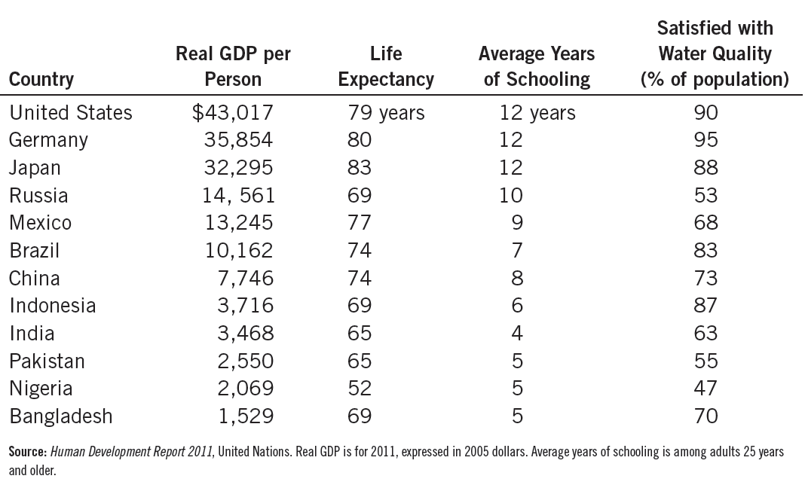
GDP and the Quality of Life
The table shows GDP per person and three other measures of the quality of life for twelve major countries.
© 2015 Cengage Learning. All Rights Reserved. May not be copied, scanned, or duplicated, in whole or in part, except for use as permitted in a license distributed with a certain product or service or otherwise on a password-protected website for classroom use.

Slide 74
Homework
P384
Q2
Q5

